Slide 1
Comparison Tool Guide
Notes:
Welcome to stockmixology, this guide will walk you through our comparison tool making easier than ever to update your portfolio.

Slide 2
Comparison Tool Guide Overview
Subscribing to a screener
Rebalancing: Comparing new screeners to previous ones
Accessing archived screener results
Notes:
It simple and involves 3 key steps:
We first show you how to sign up to screener
Then, we show you how to compare what has change since you last update
Finally, we added an archive to create a snapshot of all the times you balanced your portfolio.
That's it so let's get right to it!

Slide 3
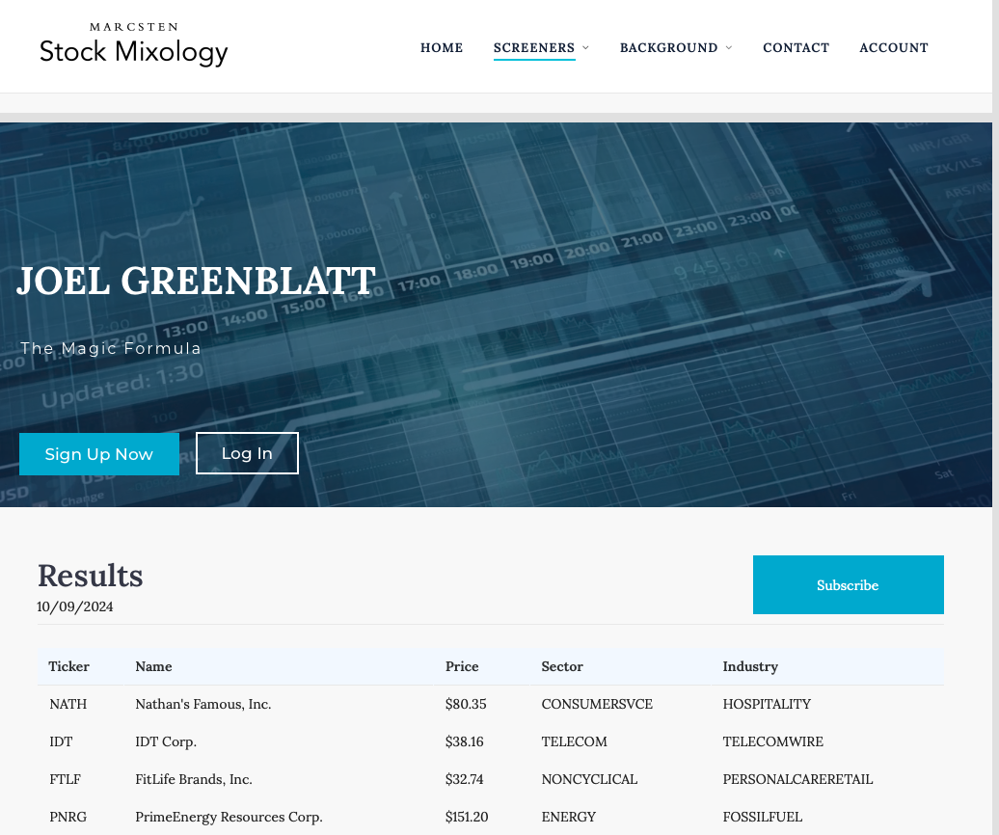
Begin by clicking ‘Subscribe’ on any screener page. You must have a Stock Mixology account to subscribe to a screener.
Subscribing to a screener
Notes:
Once you’ve logged in, you'll have the option to subscribe to any screener hosted on our page.
By subscribing, the screener is saved to your profile with all of the stocks listed on the date you subscribe. You can see on the screen the pararemeters that will be saved. Our system will create a snapshot each time you subscribe and rebalance your portfolio.

Slide 4
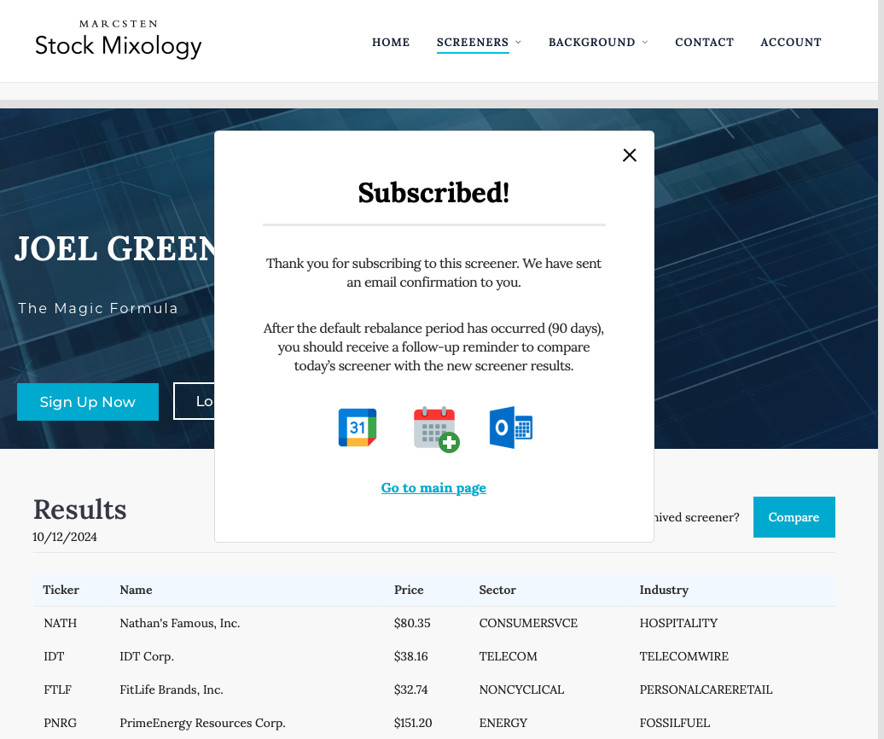
You are now subscribed as of that day’s date. You may export a reminder to your personal calendar by clicking the available calendar icons. The calendar reminder defaults to 90 days (if using one rebalance per quarter) in most situations. This prompts you to log back in to Stock Mixology next quarter to view the new list of stocks for that particular screener. You will also receive a confirmation email.
Notes:
Now, to make it easier for you to remember when it's time to revisit your strategy, we added a new feature that automatically integrate with your calendar of choice.
This will have a default time and template name. We suggest naming according to your strategy of choice to make it easier to remember. The default time is 90 days and a healthy balance that minimizes how much time you spent on this stuff.

Slide 5
2) Rebalancing: Comparing New Screeners to Previous Ones

Slide 6
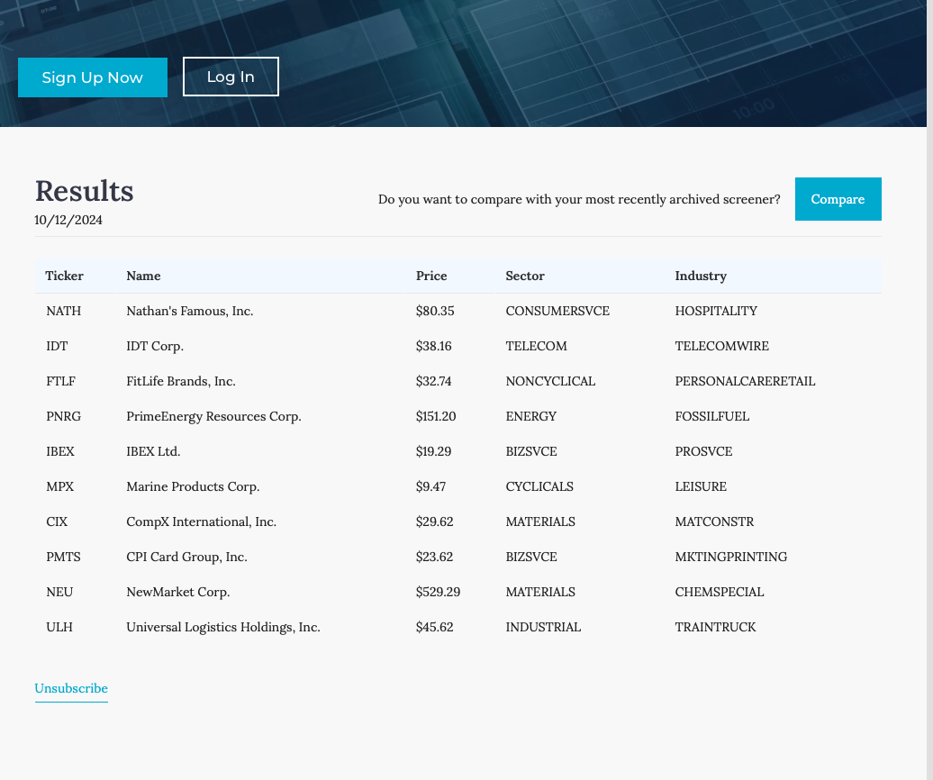
After hitting ‘Subscribe’, Stock Mixology assumes that you have taken the buying/selling actions in your own personal brokerage account to follow along with the screener. After your quarterly (by default) rebalance period, your calendar reminder should prompt you to return to Stock Mixology. Head back to the screener page and initiate the Comparison Tool by clicking the ‘Compare’ button. If at any point you would like to unsubscribe from the screener, the option is available at the bottom.

Slide 7
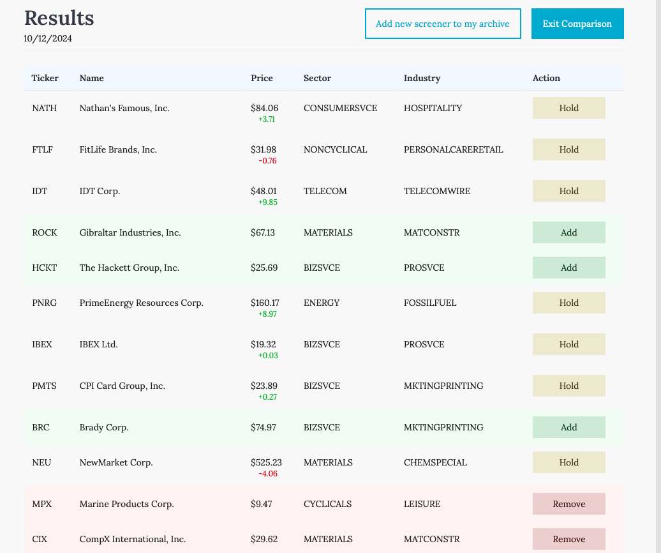
Upon entering the comparison view, Stock Mixology will compare our most recent screener results with the screener results from either your original subscription or last rebalance. Under the Action column, there are three possible options… - Add: that stock has been added to the screener results since last time - Hold: that stock is still there, as it was for you last time - Remove: that stock is no longer in the screener results The ‘Add new screener to my archive’ function is how your personalized screener gets saved to your profile. - IMPORTANT: This button must be clicked during each rebalance to properly archive to your profile for future comparisons.

Slide 8
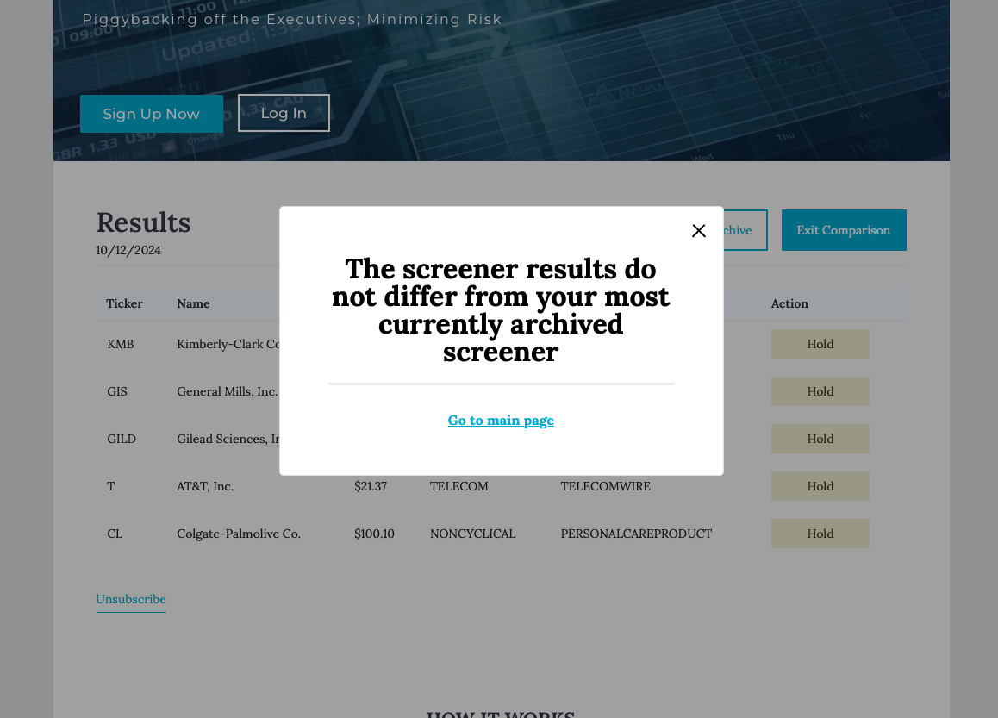
If you are worried about hitting ‘Add new screener to my archive’ twice on accident, fear not. If the stocks are the exact same (including price), Stock Mixology will not redundantly store the duplicate screener. This keeps your archived screeners profile page clean.

Slide 9
3) Accessing archived screener results

Slide 10
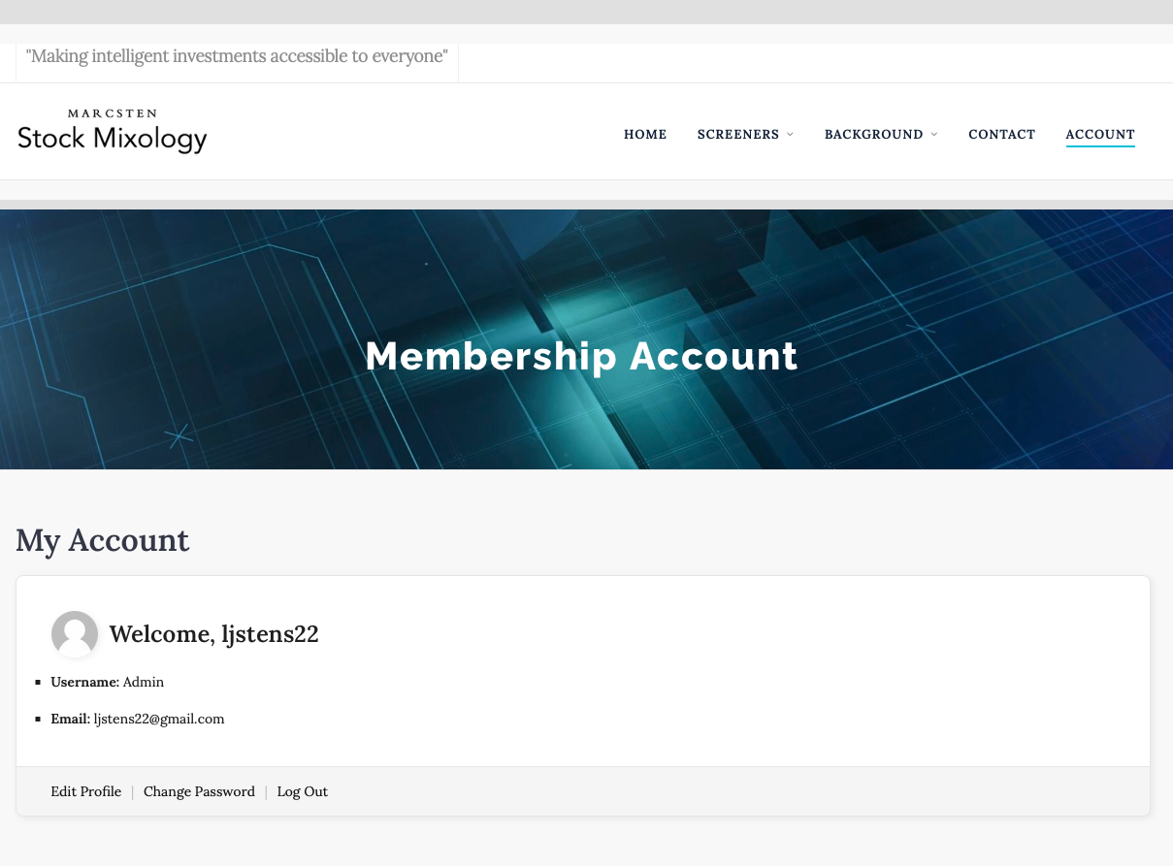
Click ‘Account’ in the top-right of the page to access your profile. Here you can see various information about your account. To view the screeners you are subscribed to, scroll down to the bottom of the page.
scroll

Slide 11
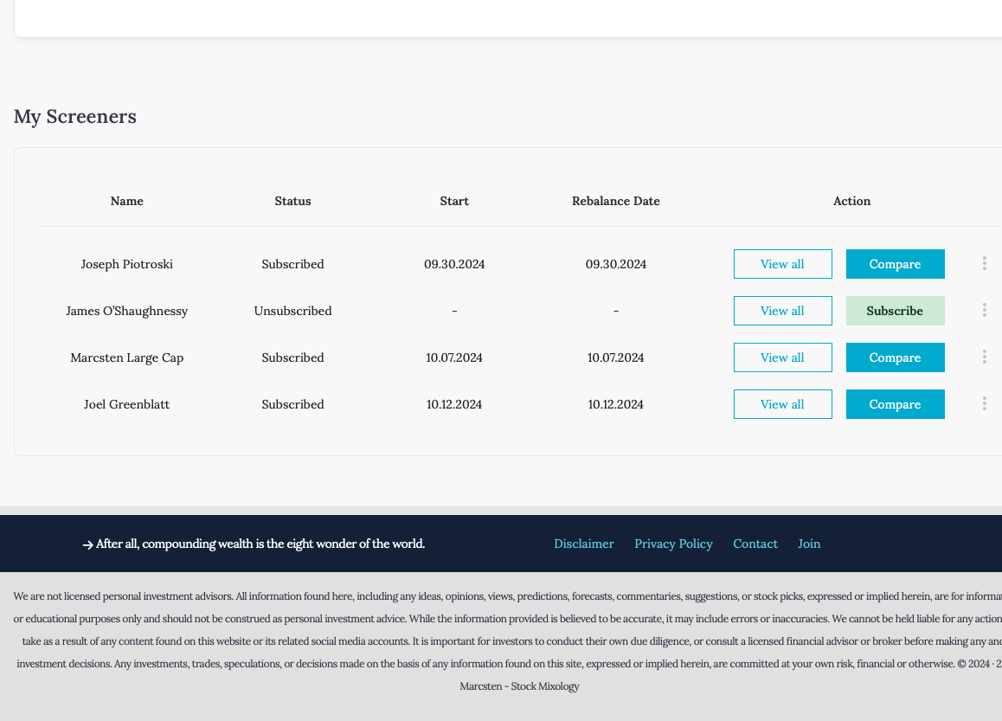
Under My Screeners, you will see all screeners you are subscribed to. There are five columns with information about each subscription. - Name: screener name - Status: subscription status - Start: when you originally started your subscription to that screener - Rebalance Date: when you most recently rebalanced, as determined by when you clicked ‘Add new screener to my archive’ on the comparison page. - Action: You may re-subscribe or enter the comparison feature from here. Also, ‘View All’ will take you to all previously archived screener results. That is where we will head next… (NOTE: due to demonstration purposes, our Start and Rebalance Dates are the same. Yours, by default, will differ by 90 days, then 180, 270, etc. for quarterly rebalancing)

Slide 12
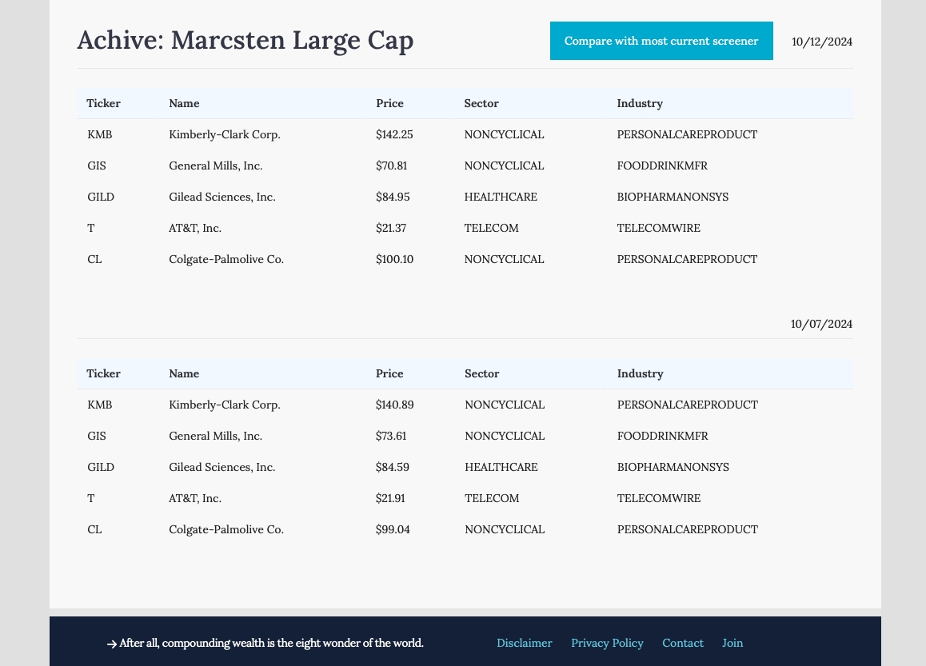
Here is an example of how all your archived screener results will store to your profile. This helps to document your trades. In this example, the stocks appear the same due to the five-day rebalance period (10/7 then 10/12), but the updated prices were nonetheless archived. Remember, Stock Mixology defaults to 90-day rebalance periods. You may also return to the Comparison Tool feature from this page.

Slide 13
Please reach out to provide feedback or ask questions:
Contact Form on website
or
Email: luke@marcsten.com,
frank@marcsten.com

